Slide 1
Fundamentals of Analogue Circuits
Hongling Cui

Slide 2


Fundamentals of Analogue Circuits
Chapter 4 Diodes
from Microelectronic Circuits Text
by Sedra and Smith
Oxford Publishing

Slide 3
Fundamentals of Analogue Circuits
Introduction
IN THIS CHAPTER WE WILL LEARN
1. the characteristics of the ideal diode and how to analyze and design circuits containing multiple ideal diodes together with resistors and dc sources to realize useful and interesting nonlinear function.
2. the details of the i-v characteristic of the junction diode (which was derived in Chapter 3) and how to use it to analyze diode circuits operating in the various bias regions: forward, reverse, and breakdown.

Slide 4
Fundamentals of Analogue Circuits
Introduction
3. a simple but effective model of the diode i-v characteristic in the forward direction: the constant-voltage-drop model
4. a powerful technique for the application and modeling of the diode (and in later chapters, transistors): dc-biasing the diode and modeling its operation for small signals around the dc-operating point by means of the small-signal model

Slide 5
Fundamentals of Analogue Circuits
5. the use of a string of forward-biased diodes and of diodes operating in the breakdown region (zener diodes), to provide constant dc voltages (voltage regulators)
6. application of the diode in the design of rectifier circuits, which convert ac voltages to dc as needed for powering electronic equipment

Slide 6
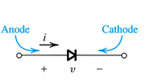
Fundamentals of Analogue Circuits
4.1.1. Current-Voltage Characteristic of the Ideal Diode
ideal diode – most fundament nonlinear circuit element
two terminal device
circuit symbol shown to right
Figure 4.1: Diode characteristics
cathode – negative terminal, from which current flows
anode – positive terminal of diode, into which current flows

Slide 7
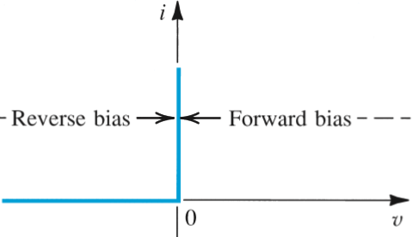
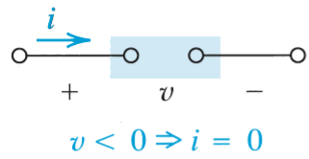
Fundamentals of Analogue Circuits
ideal diode
operates in two modes
on and off
mode#1: reverse bias = open ckt
Figure 4.1: Diode characteristics

Slide 8
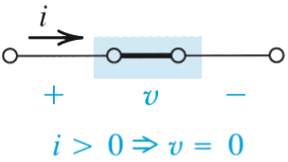
Fundamentals of Analogue Circuits
ideal diode
operates in two modes
on and off
mode#1: reverse bias = open ckt
mode#2: forward bias = short ckt
Figure 4.1: Diode characteristics

Slide 9
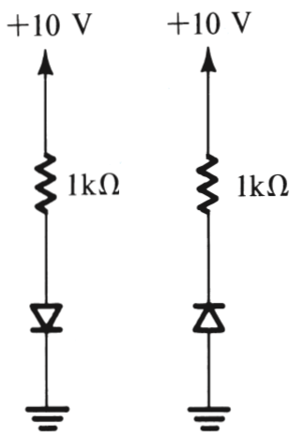

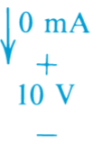

Fundamentals of Analogue Circuits
External circuit should be designed to limit…
current flow across conducting diode
voltage across blocking diode
Examples are shown to right…
Figure 4.2: The two modes of operation of ideal diodes and the use of an external circuit to limit (a) the forward current and (b) the reverse voltage.

Slide 10
Fundamentals of Analogue Circuits
ideal diode
operates in two modes
on and off

Slide 11
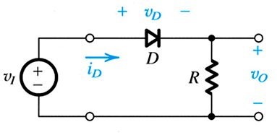
Fundamentals of Analogue Circuits
4.1.2 A Simple Application – The Rectifier
One fundamental application of this piecewise linear behavior is the rectifier.
Q: What is a rectifier?
A: Circuit which converts AC waves in to DC…ideally with no loss.
Figure 4.3(a): Rectifier Circuit

Slide 12
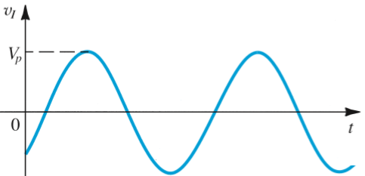
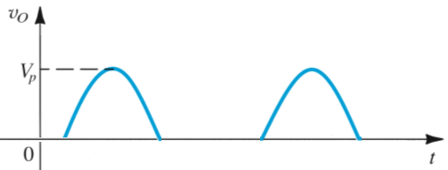
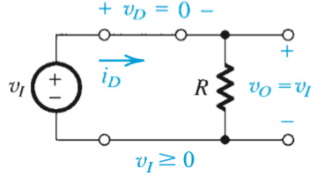
Fundamentals of Analogue Circuits
During the positive half-cycles of the input sinusoid, the diode turn on.

Slide 13
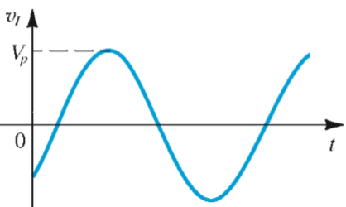
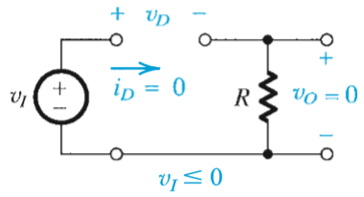
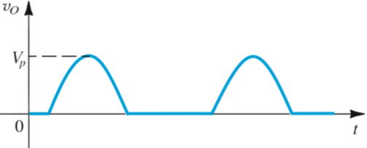
Fundamentals of Analogue Circuits
During the negative half-cycles of the input sinusoid, the diode turn off.

Slide 14
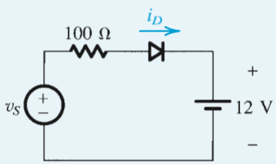
Fundamentals of Analogue Circuits
Example 4.1 Diode Rectifier
Figure 4.4(a) shows a circuit for charging a 12-V battery. If v_{S} is a sinusoid with 24-V peak amplitude, find the fraction of each cycle during which the diode conducts. Also, find the peak value of the diode current and the maximum reverse-bias voltage that appears across the diode.
Figure 4.4: Circuit for Example 4.1.

Slide 15
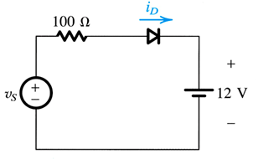
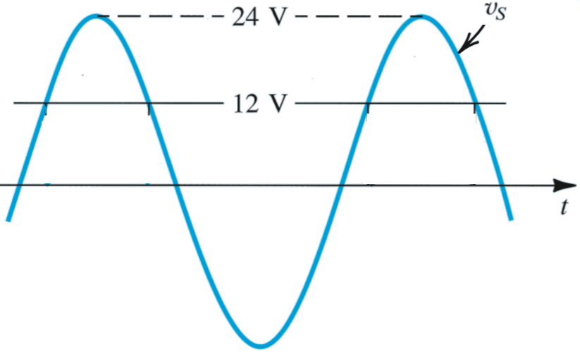
Fundamentals of Analogue Circuits
Q(a): Find the fraction of each cycle during which the diode conducts.
Q(b): Find peak value of diode current and maximum reverse-bias voltage that appears across the diode.
Figure 4.4: Circuit and Waveforms for Example 4.1.

Slide 16



Fundamentals of Analogue Circuits
Thus θ =60°and the conduction angle is 120.
The peak value of the diode current is given by
The maximum reverse voltage is equal to 24+12=36V.

Slide 17
Fundamentals of Analogue Circuits
ideal diode
operates in two modes
on and off
mode#1: reverse bias = open ckt
mode#2: forward bias = short ckt
Figure 4.1: Diode characteristics

Slide 18
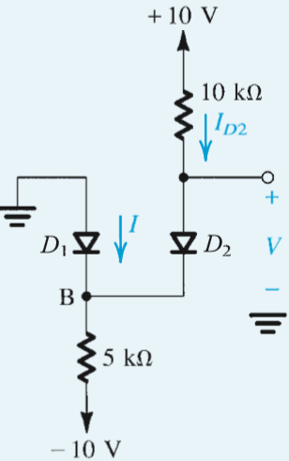
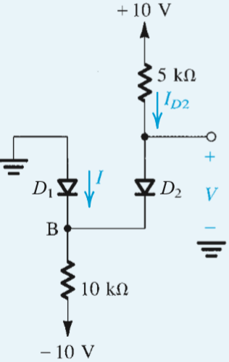
Fundamentals of Analogue Circuits
Example 4.2 (Assumed States Method)
Assuming the diodes to be ideal, find the values of I and V
Application of hypothesis method

Slide 19



Fundamentals of Analogue Circuits
Example 4.2
Assuming the diodes to be ideal, find the values of I and V
Solution:
assume that both diodes are conducting
V_{B} =0 and V =0
The current through D2 can be determined from
Writing a node equation at B
then

Slide 20



Fundamentals of Analogue Circuits
Example 4.2
Assuming the diodes to be ideal, find the values of I and V
Solution:
assume that both diodes are conducting
V_{B} =0 and V =0
The current through D2 can be determined from
Writing a node equation at B
then
Notes:
.

Slide 21

Fundamentals of Analogue Circuits
Example 4.2
Assuming the diodes to be ideal, find the values of I and V
Solution:
assume D1 is off and D2 is on
The current through D2 can be determined from
Then the voltage at node B is
Therefor D1 is reverse biased as assumed.

Slide 22
Fundamentals of Analogue Circuits
4.2. Terminal Characteristics of Junction Diodes
Most common implementation of a diode utilizes pn junction.

Slide 23
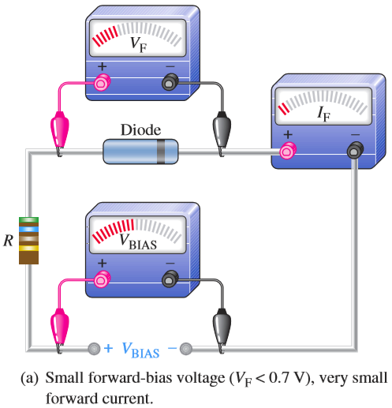
Fundamentals of Analogue Circuits
4.2.1. The Forward-Bias Region
Example: measurement of i–v characteristic of 1N4001
Measurement data
v_{D} | i_{D}
0.000V | 0.000μA
0.100V | 0.189μA
0.200V | 1.496μA
0.300V | 10.527μA
0.400V | 72.940μA
0.500V | 504.126μA
0.535V | 1.000mA
0.571V | 2.000mA
0.592V | 3.000mA
0.600V | 3.476mA
0.700V | 23.625mA
0.800V | 147.375mA
0.900V | 663.944mA
1.000V | 1.796A
measurement of circuit
R
D
E
V
mA

Slide 24
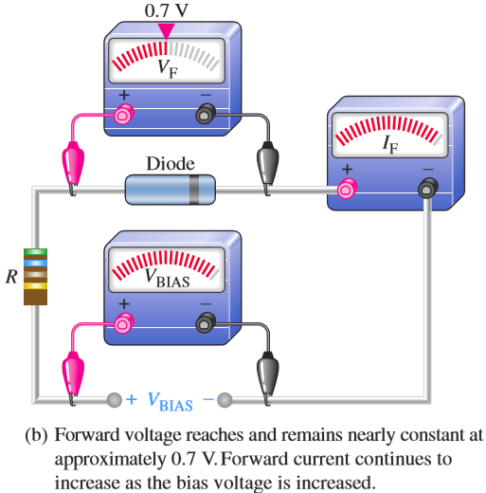
Fundamentals of Analogue Circuits
Example: measurement of i–v characteristic of 1N4001
Measurement data
v_{D} | i_{D}
0.000V | 0.000μA
0.100V | 0.189μA
0.200V | 1.496μA
0.300V | 10.527μA
0.400V | 72.940μA
0.500V | 504.126μA
0.535V | 1.000mA
0.571V | 2.000mA
0.592V | 3.000mA
0.600V | 3.476mA
0.700V | 23.625mA
0.800V | 147.375mA
0.900V | 663.944mA
1.000V | 1.796A
measurement of circuit
R
D
E
V
mA

Slide 25
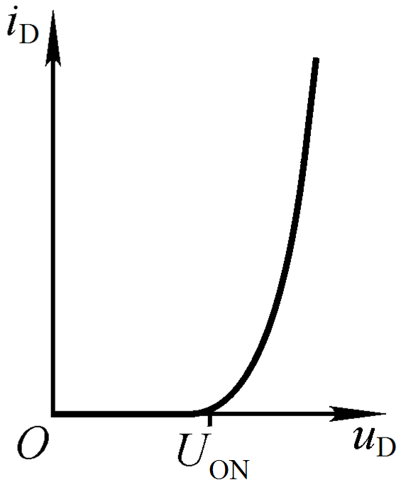
Fundamentals of Analogue Circuits
Example: measurement of i–v characteristic of 1N4001
Measurement data
The i–v characteristic of the forward…
v_{D} | i_{D}
0.000V | 0.000μA
0.100V | 0.189μA
0.200V | 1.496μA
0.300V | 10.527μA
0.400V | 72.940μA
0.500V | 504.126μA
0.535V | 1.000mA
0.571V | 2.000mA
0.592V | 3.000mA
0.600V | 3.476mA
0.700V | 23.625mA
0.800V | 147.375mA
0.900V | 663.944mA
1.000V | 1.796A
fully conducting region

Slide 26
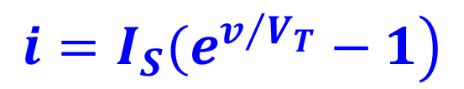
Fundamentals of Analogue Circuits
4.2.1. The Forward-Bias Region
I-V relationship is closely approximated by equations to right.
The forward-bias region of operation is entered when v > 0.
where I_{S} is a constant for a given diode at a given temperature.
the voltage V_{T} is a constant called the thermal voltage.
At room temperature (20°C) the value of V_{T} is 25.3 mV. In rapid approximate circuit analysis we shall use V_{T} ≈25mV at room temperature.

Slide 27
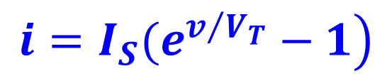
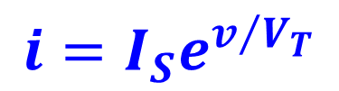
Fundamentals of Analogue Circuits
4.2.1. The Forward-Bias Region
The forward-bias region of operation is entered when v > 0.
I-V relationship is closely approximated by equations to right.
when

Slide 28
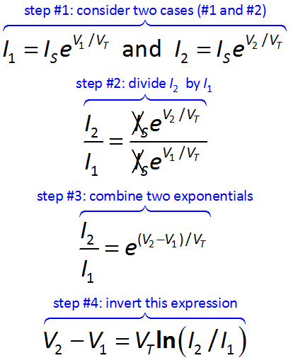
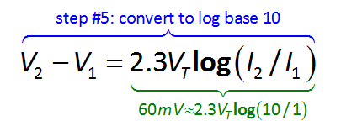
Fundamentals of Analogue Circuits
Q: What is the relative effect of current flow (i) on forward biasing voltage (v)?
A: Very small.
10x change in i, effects 60mV change in v.

Slide 29
Fundamentals of Analogue Circuits
4.2.2. The Reverse-Bias Region
Measurement data
reverse-bias
u_{D} | i_{D}
0.000V | 0.000μA
-0.0625V | -0.022μA
-0.125V | -0.029μA
-0.250V | -0.032μA
-0.500V | -0.032μA
-1.000V | -0.033μA
-2.000V | -0.034μA
-4.000V | -0.036μA
-8.000V | -0.040μA
-16.000V | -0.048μA
-32.000V | -0.064μA
-50.000V | -0.082μA
-52.907V | -1.000μA
-53.027V | -100.000μA
-53.147V | -10.000mA
R
D
E
V
μA

Slide 30
Fundamentals of Analogue Circuits
4.2.2. The Reverse-Bias Region
The reverse-bias region of operation is entered when v < 0.
I-V relationship, for negative voltages with |v| > 3V_{T} (25mV), is closely approximated by equations to right.

Slide 31
Fundamentals of Analogue Circuits
4.2.3 The Breakdown Region
Measurement data
reverse-bias
v_{D} | i_{D}
0.000V | 0.000μA
-0.0625V | -0.022μA
-0.125V | -0.029μA
-0.250V | -0.032μA
-0.500V | -0.032μA
-1.000V | -0.033μA
-2.000V | -0.034μA
-4.000V | -0.036μA
-8.000V | -0.040μA
-16.000V | -0.048μA
-32.000V | -0.064μA
-50.000V | -0.082μA
-52.907V | -1.000μA
-53.027V | -100.000μA
-53.147V | -10.000mA
R
D
E
V
μA

Slide 32
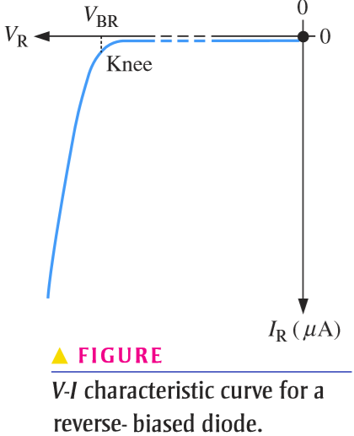
Fundamentals of Analogue Circuits
4.2.2. The Reverse-Bias Region
Measurement data
The i–v characteristic of the reverse…
v_{D} | i_{D}
0.000V | 0.000μA
-0.0625V | -0.022μA
-0.125V | -0.029μA
-0.250V | -0.032μA
-0.500V | -0.032μA
-1.000V | -0.033μA
-2.000V | -0.034μA
-4.000V | -0.036μA
-8.000V | -0.040μA
-16.000V | -0.048μA
-32.000V | -0.064μA
-50.000V | -0.082μA
-52.907V | -1.000μA
-53.027V | -100.000μA
-53.147V | -10.000mA

Slide 33
Fundamentals of Analogue Circuits
4.2.3 The Breakdown Region
The breakdown region of operation is entered when v < V_{ZK}.
Zener-Knee Voltage (V_{ZK})
This is normally
non-destructive.
I_{max}< P_{max}/V_{Z}
breakdown region

Slide 34
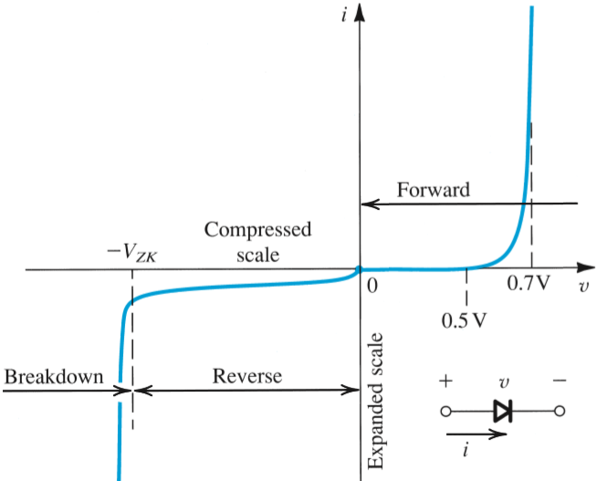
Fundamentals of Analogue Circuits
Terminal Characteristics of Junction Diodes
I-V curve consists of three characteristic regions
forward bias: v > 0
reverse bias: v < 0
breakdown: v <-V_{ZK}

Slide 35
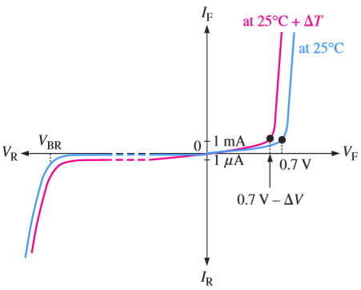
Fundamentals of Analogue Circuits
Temperature Effects
Since both I_{S} and V_{T} are functions of temperature, the forward i–v characteristic varies with temperature
Figure 4.9 Temperature dependence of the diode forward characteristic. At a constant current, the voltage drop decreases by approximately 2 mV for every 1°C increase in temperature.

Slide 36
Fundamentals of Analogue Circuits
cut-in voltage – is voltage, below which, minimal current flows
approximately 0.5V
fully conducting region – is region in which R_{diode} is approximately equal 0
between 0.6 and 0.8V
fully conducting region

Slide 37
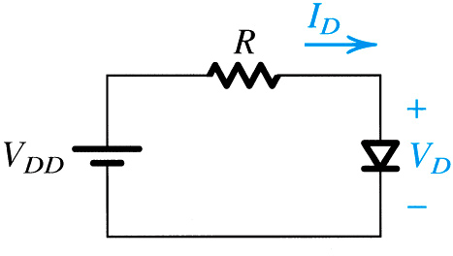
Fundamentals of Analogue Circuits
4.3. Modeling the Diode Forward Characteristic
Discuss simplified diode models better suited for use in circuit analyses:
exponential model
constant voltage-drop model
ideal diode model
small-signal (linearization) model

Slide 38
Fundamentals of Analogue Circuits
4.3.1 The Exponential Model
exponential diode model
most accurate
most difficult to employ in circuit analysis
due to nonlinear nature

Slide 39
Fundamentals of Analogue Circuits
4.3.1 The Exponential Model
Q: How does one solve for I_{D} in circuit to right?
V_{DD} = 5V
R = 1kΩ
I_{D} = 1mA @ 0.7V
Figure 4.10: A simple circuit used to illustrate the analysis of circuits in which the diode is forward conducting.
A: Two methods exist…
graphical method
iterative method

Slide 40
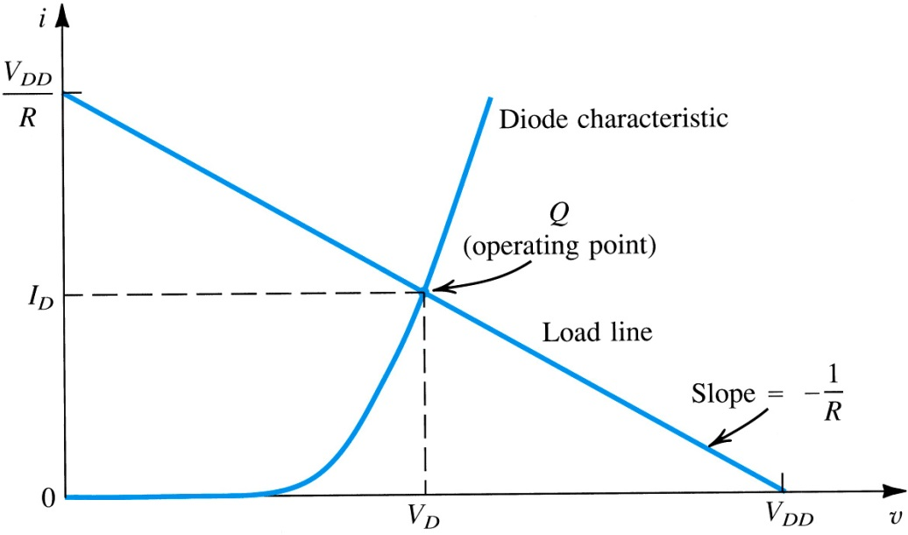
Fundamentals of Analogue Circuits
4.3.2 Graphical Analysis Using the Exponential Model
step1: Plot the relationships of these two equations on single graph
step 2: Find intersection of the two curves
load line and diode characteristic intersect at operating point
Figure 4.11: Graphical analysis of the circuit in Fig. 4.10 using the exponential diode model.

Slide 41
Fundamentals of Analogue Circuits
Pro’s
Intuitive
Con’s
Poor Precision
Not Practical for Complex Analyses
Figure 4.11: Graphical analysis of the circuit in Fig. 4.10 using the exponential diode model.

Slide 42

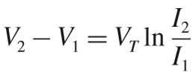

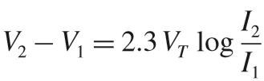

Fundamentals of Analogue Circuits
4.3.1 The Exponential Model
V_{DD} = 5V
R = 1kΩ
I_{D} = 1mA @ 0.7V
Assume V_{D} =0.7V
= 4.3mA

Slide 43

Fundamentals of Analogue Circuits
4.3.1 The Exponential Model
V_{DD} = 5V
R = 1kΩ
I_{D} = 1mA @ 0.7V
Assume V_{D} =0.7V
= 4.3mA
Substituting 2.3V_{T} =60mV, V₁ =0.7V, I₁ =1mA, and I₂ =4.3mA results in V₂ =0.738V.

Slide 44
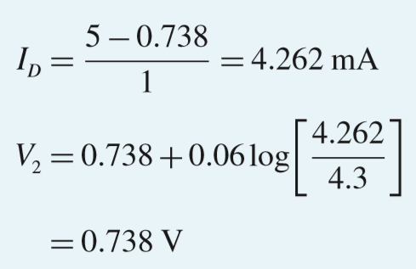

Fundamentals of Analogue Circuits
4.3.3 Iterative Analysis Using the Exponential Model
I₂ =4.3mA
V₂ =0.738V
I_{D}= 4.262 mA
V₂ = 0.738 V

Slide 45
Fundamentals of Analogue Circuits
4.3.3 Iterative Analysis Using the Exponential Model
I_{D}= 4.262 mA
V₂ = 0.738 V

Slide 46
Fundamentals of Analogue Circuits
4.3.5. The Constant Voltage-Drop Model
Q: How can one analyze these diode-based circuits more efficiently?
A: Find a simpler model.
One example is assume that voltage drop across the diode is constant.

Slide 47
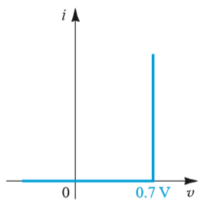
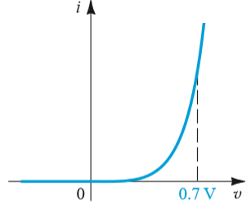
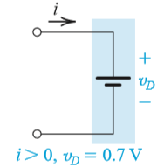
Fundamentals of Analogue Circuits
The constant voltage-drop diode model assumes that the slope of I_{D} vs. V_{D} is vertical @ 0.7V
the model of the foward–conducting diodes
approximating the exponential characteristic by a constant voltage

Slide 48


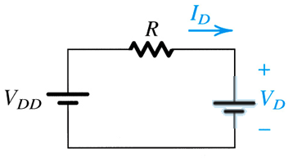

Fundamentals of Analogue Circuits
Q: How does example 4.4 solution change if CVDM is used?
A: 4.262mA to 4.3mA
1kΩ
5V
1kΩ
5V

Slide 49
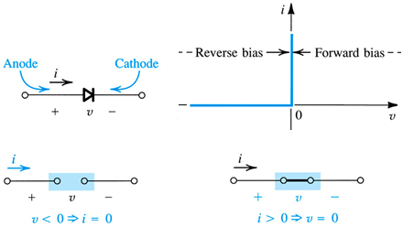
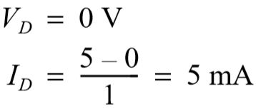
Fundamentals of Analogue Circuits
The ideal diode model assumes that the slope of I_{D} vs. V_{D} is vertical @ 0V
Q: How does example 4.4 solution change if ideal model is used?
A: 4.262mA to 5mA
1kΩ
5V

Slide 50
Fundamentals of Analogue Circuits
How to use these models?
exponential model
low voltages
less complex circuits
emphasis on accuracy over practicality
constant voltage-drop mode:
medium voltages = 0.7V
more complex circuits
emphasis on practicality over accuracy
ideal diode model
high voltages >> 0.7V
very complex circuits
cases where a difference in voltage by 0.7V is negligible

Slide 51
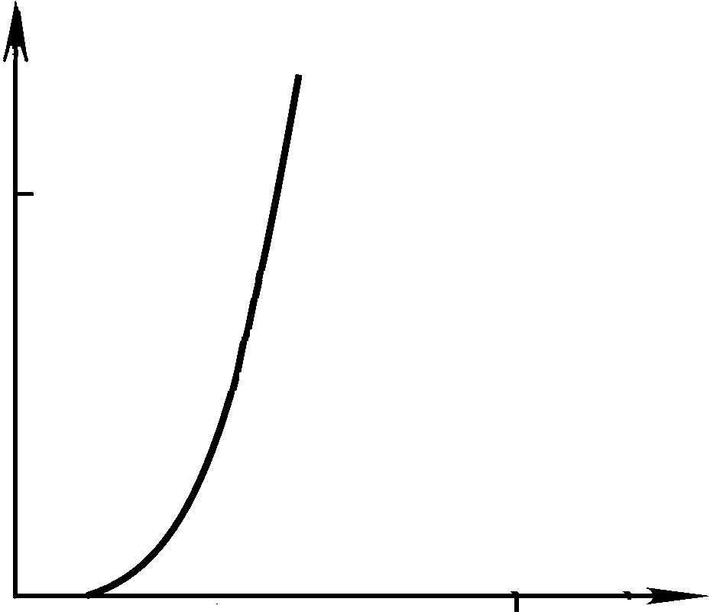

Fundamentals of Analogue Circuits
4.3.7 Small-Signal Model
Why we need the small signal method?
transmit the signal through nonlinear devices.
No distortion.
i_{D}
R
D
v_{D}
V_{DQ}
V_{D}
t

Slide 52
Fundamentals of Analogue Circuits
i_{D}
R
V_{D}/R
Q’
V_{D}
D
I_{DQ}
Q
Q”
v_{D}
O
V_{DQ}
V_{D}
DC offset
v_{D}
t
v_{d}
total signal
Small signal

Slide 53
Fundamentals of Analogue Circuits
R
i_{D}
V_{D}
(V_{D+}Δv)/R
D
V_{D}/R
Δi_{d}
I_{DQ}
Q
v_{D}
O
V_{DQ}
V_{D}
Δv
Δv_{d}

Slide 54
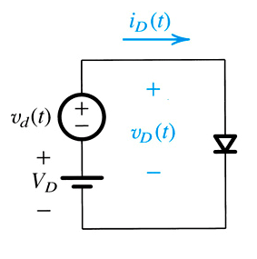
Fundamentals of Analogue Circuits
Q: How is the small-signal diode model defined?
step #1: Consider the conceptual circuit of Figure 4.13(a).
DC voltage (V_{D}) is applied to diode
Upon V_{D}, arbitrary time-varying signal v_{d} is super-imposed

Slide 55
Fundamentals of Analogue Circuits
step #2: Define DC current as in (4.8).
step #3: Define total instantaneous voltage (v_{D}) as composed of V_{D} and v_{d}.
step #4: Define total instantaneous current (i_{D}) as function of v_{D}.
R
V_{D}
D
+
-

Slide 56
Fundamentals of Analogue Circuits
step #5: replace v_{D} with (V_{D}+v_{d} ).
step #6: Split this exponential in two.
step #7: Redefine total instant current in terms of DC component (I_{D}) and time-varying voltage (v_{d}).

Slide 57
Fundamentals of Analogue Circuits
step #8: Apply power series expansion to (4.12).
step #9: Because v_{d}/V_{T} << 1, certain terms may be neglected.

Slide 58
Fundamentals of Analogue Circuits
small signal approximation
Shown to right for exponential diode model.
total instant current (i_{D})
small-signal current (i_{d.})
small-signal resistance (r_{d.})
Valid for for v_{d} < 5mV amplitude (not peak to peak).

Slide 59
Fundamentals of Analogue Circuits
Q: How is small-signal resistance r_{d} defined?
A: From steady-state current (I_{D}) and thermal voltage (V_{T}) as below.
Note this approximation is only valid for small-signal voltages v_{d} < 5mV.
T=20℃：

Slide 60
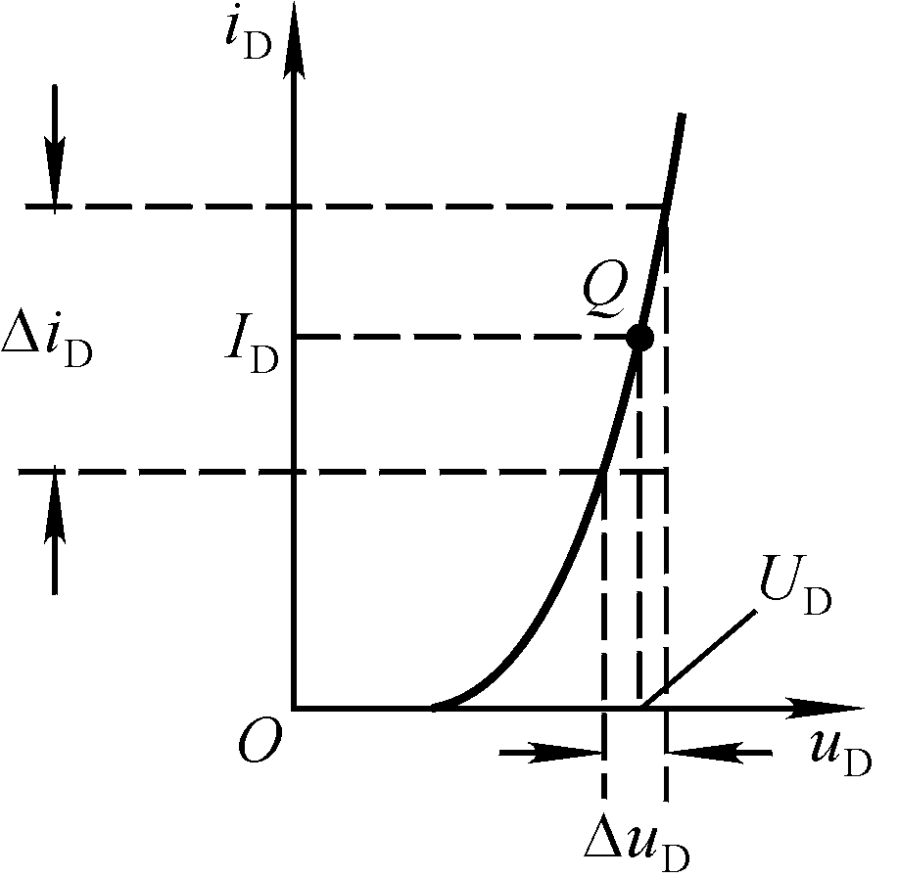
Fundamentals of Analogue Circuits
Another solution is to seek derivatives.
Quiescent point

Slide 61
Fundamentals of Analogue Circuits
differentiate：
T=20℃：

Slide 62
Fundamentals of Analogue Circuits
R
i_{D}
V_{D}
D
V_{D}/R
Q’
I_{DQ}
Q
Q”
v_{D}
O
V_{DQ}
V_{D}
v_{D}
t
v_{d}

Slide 63
Fundamentals of Analogue Circuits
Summary of Small-Signal Model
The total instantaneous circuit is divided into steady-state and time varying components, which may be analyzed separately and solved via algebra.
In steady-state, diode represented as CVDM.
In time-varying, diode represented as resistor.

Slide 64
Fundamentals of Analogue Circuits
A systematic procedure for finding incremental voltages and currents for a circuit containing a diode is as follows:
1. Find the DC operating variables, I_{D} and V_{D}, using the subcircuit derived from the original circuit by setting all small-signal sources to zero..

Slide 65
Fundamentals of Analogue Circuits
A systematic procedure for finding incremental voltages and currents for a circuit containing a diode is as follows:
1. Find the DC operating variables, I_{D} and V_{D}, using the subcircuit derived from the original circuit by setting all small-signal sources to zero..
2. Find the small signal (incremental) voltage and the small signal diode current by forming a small signal subcircuit in which the diode is replaced by a resistor of value r_{d}, and all DC sources are set to zero.

Slide 66
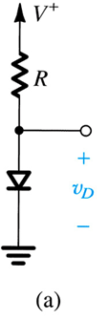
Fundamentals of Analogue Circuits
Example 4.5 Small-Signal Model
The power supply V⁺ has a dc value of 10V over which is superimposed a 60Hz sinusoid of 1V peak amplitude (known as the ripple)
Assume diode to have 0.7V drop at 1mA current.
Q: Calculate the amplitude of the sine-wave signal appearing across the diode.
10kΩ

Slide 67
Fundamentals of Analogue Circuits
And small signal analysis comprises the following steps:
Find the DC operating variables I_{D} and V_{D} by setting all small-signal sources to zero.
Find the incremental device voltage v_{d} by forming a small signal subcircuit in which the diode is replaced by a linear resistor of value r_{d}, and all DC sources are set to zero.

Slide 68
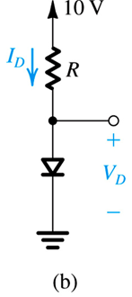


Fundamentals of Analogue Circuits
Considering dc quantities only, we assume V_{D} ≈ 0.7 V and calculate the diode dc current
10kΩ
At this operating point, the diode incremental resistance r_{d} is

Slide 69
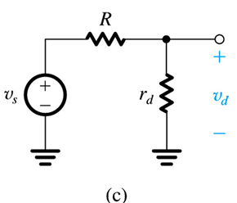
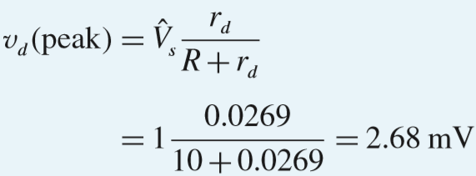
Fundamentals of Analogue Circuits
The signal voltage across the diode can be found from the small-signal equivalent circuit
10kΩ
Using the voltage-divider rule provides the peak amplitude of vd as follows:

Slide 70
Fundamentals of Analogue Circuits
Example 4.5 Small-Signal Model
The power supply V⁺ has a dc value of 10V over which is superimposed a 60Hz sinusoid of 1V peak amplitude (known as the ripple)
Assume diode to have 0.7V drop at 1mA current.
Q: Calculate the amplitude of the sine-wave signal appearing across the diode.
10kΩ

Slide 71
Fundamentals of Analogue Circuits
Considering dc quantities only, we assume V_{D} ≈ 0.7 V and calculate the diode dc current
10kΩ
At this operating point, the diode incremental resistance r_{d} is

Slide 72
Fundamentals of Analogue Circuits
The signal voltage across the diode can be found from the small-signal equivalent circuit
10kΩ
Using the voltage-divider rule provides the peak amplitude of vd as follows:

Slide 73
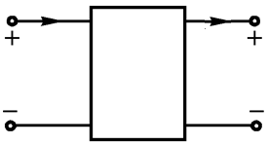
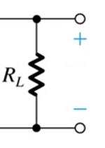
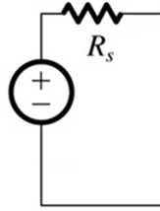

Fundamentals of Analogue Circuits
4.3.8 Voltage Regulation
Q: What is a voltage regulator?
maintains a constant dc output voltage, regardless of variations in the input voltage or the load.
I_{L}
V_{i}
V_{o}

Slide 74

Fundamentals of Analogue Circuits
4.3.8 Use of Diode Forward Drop in Voltage Regulation
Q: What characteristic of the diode facilitates voltage regulation?
A: The approximately constant voltage drop across it (0.7V).

Slide 75

Fundamentals of Analogue Circuits
Example 4.6:Diode-Based Voltage Regulator
Consider circuit shown in Figure 4.15. A string of three diodes is used to provide a constant voltage of 2.1V.
Q: What is the change in this regulated voltage caused by
a ± 10% change in supply voltage
connection of 1kΩ load resistor
Figure 4.15: Circuit for Example 4.6.

Slide 76





Fundamentals of Analogue Circuits
With no load, the nominal value of the current in the diode string is given by
Thus each diode will have an incremental resistance of
I
The three diodes in series will have a total incremental resistance of

Slide 77


Fundamentals of Analogue Circuits
When supply voltage is changed by ±10% (i.e., ±1V), the peak-to-peak change in output voltage will be
r

Slide 78

Fundamentals of Analogue Circuits
With no load, the nominal value of the current in the diode string is given by
a total incremental resistance of
I
Notes:
.

Slide 79

Fundamentals of Analogue Circuits
When a load resistance of 1kΩ is connected across the diode string, it draws a current of about 2.1mA. Thus the current in the diodes decreases by 2.1mA, resulting in a decrease in voltage across the diode string given by
10V

Slide 80
Fundamentals of Analogue Circuits
4.4 Operation in the Reverse Breakdown
Region – Zener Diodes
i
These are referred to as Zener Diodes.
V
_{Z0}
V
V
_{ZK}
_{Z}
0
I
v
_{ZK}
Slope
1
r
_{z}
Q
I
V
I

Slide 81
Fundamentals of Analogue Circuits
I_{Z}
+
V_{Z}
-
Circuit symbol for a zener diode
4.4.1 Specifying and Modeling the Zener Diode

Slide 82

Fundamentals of Analogue Circuits
The diode i–v characteristic with the breakdown region
The Model for the zener diode
i
V
_{Z0}
V
V
_{ZK}
_{Z}
0
I
v
_{ZK}
ΔV=ΔI r_{z}
Slope
1
r
_{z}
Q
I
_{ZT}
(
test current
)
Δ
V
Δ
I
I_{max}

Slide 83
Fundamentals of Analogue Circuits
I’ll give you 10 minutes to read pages 203 to 204 of the textbook.
4.4.1 Specifying and Modeling the Zener Diode

Slide 84

Fundamentals of Analogue Circuits
The 6.8-V zener diode in the circuit of Fig.4.21(a) is specified to have V_{Z} =6.8V at I_{Z} =5mA, r_{z}=20Ω, and I_{ZK} =0.2mA. The supply voltage V⁺ is nominally 10V but can vary by±1V.
(a) Find V_{O} with no load and with V⁺ at its nominal value.
(b) Find the change in V_{O} resulting from the ±1-V change in V⁺. Note that
(∆V_{O} /∆ V⁺), usually expressed in mV/V, is known as line regulation.

Slide 85

Fundamentals of Analogue Circuits
(c) Find the change in V_{O} resulting from connecting a load resistance R_{L} that draws a current I_{L} =1mA, and hence find the load regulation (∆V_{O} /∆I_{L}) in mV/mA
(d) Find the change in V_{O} when R_{L} =2kΩ.
(e) Find the value of V_{O} when R_{L} =0.5kΩ.
(f) What is the minimum value of R_{L} for which the diode still operates in the breakdown region?

Slide 86



Fundamentals of Analogue Circuits
(a) Find V_{O} with no load and with V⁺ at its nominal value.
V_{Z} =V_{Z0}+r_{z}I_{Z}
→ V_{Z0}= V_{Z} – r_{z}I_{Z}=6.7V

Slide 87



Fundamentals of Analogue Circuits
(b) Find the change in V_{O} resulting from the ±1V change in V⁺. Note that (∆V_{O} /∆ V⁺), usually expressed in mV/V, is known as line regulation.

Slide 88



Fundamentals of Analogue Circuits
(c) Find the change in V_{O} resulting from connecting a load resistance R_{L} that draws a current I_{L} =1mA, and hence find the load regulation (∆V_{O} /∆I_{L}) in mV/mA

Slide 89


Fundamentals of Analogue Circuits
(d) Find the change in V_{O} when R_{L} =2kΩ.
(e) Find the value of V_{O} when R_{L} =0.5kΩ.
(d)
I_{L}=6.8V/2kΩ=3.4mA
(e)
I_{L}=6.8V/0.5kΩ=13.6mA

Slide 90

Fundamentals of Analogue Circuits
(f) What is the minimum value of R_{L} for which the diode still operates in the breakdown region?
I_{Z} =I_{ZK} =0.2mA
and V_{Z} ≈V_{ZK} ≈ 6.7V
I= (9−6.7)/0.5=4.6mA
I_{L}= 4.6−0.2=4.4mA

Slide 91

Fundamentals of Analogue Circuits
§4.5 Rectifier Circuits
One important application of diode is the rectifier –
Electrical device which converts alternating current (AC) to direct current (DC)
One important application of rectifier is dc power supply.

Slide 92

Fundamentals of Analogue Circuits
step #1: increase / decrease amplitude of AC wave via
power transformer
step #2: convert full-wave AC to half-wave DC (still time-
varying and periodic)
step #3: employ low-pass filter to reduce wave amplitude
step #4: employ voltage regulator to eliminate ripple
step #5: supply dc load

Slide 93

Fundamentals of Analogue Circuits
4.5.1. The Half-Wave Rectifier
utilizes only alternate half-cycles of the input sinusoid
Constant voltage drop diode model is employed.
Figure 4.21: (a) Half-wave rectifier

Slide 94


Fundamentals of Analogue Circuits
if v_{i} ≥ V_{D} , the diode turn on, v_{O} =v_{i}−V_{D}.
V_{p}−V_{D}

Slide 95

Fundamentals of Analogue Circuits
if v_{i} < V_{D}, the diode turn off. Then v_{o}=0.
dc-impulse voltage

Slide 96

Fundamentals of Analogue Circuits
4.5.1. The Half-Wave Rectifier
peak inverse voltage
utilizes only alternate half-cycles of the input sinusoid
Constant voltage drop diode model is employed.
PIV = V_{s}
Figure 4.21: (a) Half-wave rectifier (b) Transfer characteristic of the rectifier circuit (c) Input and output waveforms

Slide 97

Fundamentals of Analogue Circuits
4.5.1. The Half-Wave Rectifier
utilizes only alternate half-cycles of the input sinusoid
Constant voltage drop diode model is employed.
v_{o} =v_{S}−V_{D} when v_{S} ≥ V_{D}
v_{o}=0 when v_{S} < V_{D}
Figure 4.21: (a) Half-wave rectifier (b) Transfer characteristic of the rectifier circuit (c) Input and output waveforms

Slide 98
Fundamentals of Analogue Circuits
4.5.1. The Half-Wave Rectifier
Pro’s
simple
Con’s
Low efficiency

Slide 99

Fundamentals of Analogue Circuits
4.5.2. The Full-Wave Rectifier
Q: How does full-wave rectifier differ from half-wave?
A: It utilizes both halves of the input

Slide 100


Fundamentals of Analogue Circuits

Slide 101



Fundamentals of Analogue Circuits
PIV = 2V_{s} − V_{D}
Figure 4.22: Full-wave rectifier utilizing a transformer with a center-tapped secondary winding.

Slide 102

Fundamentals of Analogue Circuits
4.5.3 The Bridge Rectifier
An alternative implementation of the full-wave rectifier is bridge rectifier.
Figure 4.23: The bridge rectifier circuit.

Slide 103
Fundamentals of Analogue Circuits
when instantaneous source voltage is positive,
D₁ and D₂ conduct while D₃ and D₄ block
Figure 4.23: The bridge rectifier circuit.

Slide 104
Fundamentals of Analogue Circuits
when instantaneous source voltage is negative,
D₃ and D₄ conduct while D₁ and D₂ block
PIV = V_{s} − V_{D}
Figure 4.23: The bridge rectifier circuit.

Slide 105

Fundamentals of Analogue Circuits
4.5.4 The Rectifier with a Filter Capacitor—The Peak Rectifier
A simple way to reduce the variation of the output voltage is to place a capacitor across the load resistor.

Slide 106

Fundamentals of Analogue Circuits
Figure 4.25 Voltage and current waveforms in the peak rectifier circuit with CR T. The diode is assumed ideal.

Slide 107
Fundamentals of Analogue Circuits
4.5.5 Precision Half-Wave Rectifier—The Superdiode The rectifier circuits studied thus far suffer from having one or two diode
There are other applications, however, where the signal to be rectified is small (e.g., on the order of 100 mV or so) and thus clearly insufficient to turn on a diode. Also, in instrumentation applications, the need arises for rectifier circuits with very precise and predictable transfer characteristics.

Slide 108




Fundamentals of Analogue Circuits
For small signal applications, a class of circuits has been developed utilizing op amps together with diodes to provide precision rectification.
Figure 4.27 The “superdiode” precision half-wave rectifier and its almost-ideal transfer characteristic. Note that when v_{I} > 0 and the diode conducts, the op amp supplies the load current, and the source is conveniently buffered, an added advantage. Not shown are the op-amp power supplies.

Slide 109


Fundamentals of Analogue Circuits
4.6 Limiting and Clamping Circuits
A nonlinear device that limits the output voltage to a particular level.
Be used for waveform transformation, waveform shaping, overvoltage protection……
input
output
limiter

Slide 110

Fundamentals of Analogue Circuits
If input ≥ Positive limit, output =Positive limit.
If input ≤ Negative limit,
output = Negative limit
otherwise, output =input.

Slide 111


Fundamentals of Analogue Circuits
4.6 Limiting and Clamping Circuits
v_{o} =v₁+V_{D} when v_{IN} ≥ v₁+V_{D}
v_{o}=v_{IN} when v_{IN}< v₁+V_{D}
Figure 4.31 (d) basic limiting circuits.

Slide 112

Fundamentals of Analogue Circuits
4.6 Limiting and Clamping Circuits
Figure 4.31 (c) basic limiting circuits.

Slide 113

Fundamentals of Analogue Circuits
EXERCISE 4.26 Assuming the diodes to be ideal, describe the transfer characteristic of the circuit shown in Fig. E4.26.
v_{o}=v_{IN} when -5V < v_{IN} < 5V

Slide 114
Fundamentals of Analogue Circuits
EXERCISE 4.26 Assuming the diodes to be ideal, describe the transfer characteristic of the circuit shown in Fig. E4.26.
when v_{IN} ≥ 5V
I

Slide 115
Fundamentals of Analogue Circuits
EXERCISE 4.26 Assuming the diodes to be ideal, describe the transfer characteristic of the circuit shown in Fig. E4.26.
when v_{IN} ≥ 5V
I

Slide 116



Fundamentals of Analogue Circuits
4.6.2 The Clamped Capacitor or DC Restorer

Slide 117



Fundamentals of Analogue Circuits
4.6.3 The Voltage Doubler
D
D
Figure 4.34 Voltage doubler: (a) circuit; (b) waveform of the voltage across D₁.

Slide 118


Fundamentals of Analogue Circuits
Simulation
The model of the diode is 1N4148,
C₁= C₂=10μF
Observing the output waveform at steady state , we apply the DC supply V_{K}=+5V, V_{K}=0V respectively.

Slide 119
Fundamentals of Analogue Circuits

